Slide 1


REprecsys
Reproducible Template Systems for Deploying Infrastructure

Slide 2
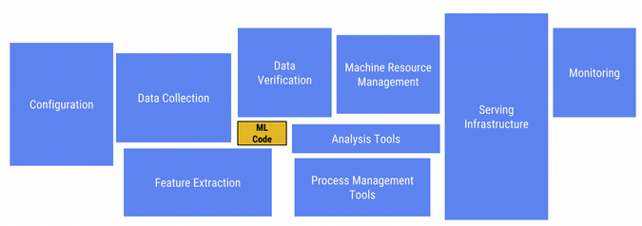
Why REPRECSYS ?
1. Only a small fraction of real-world ML systems is composed of the ML code, as shown by the small box in the middle. The required surrounding infrastructure is vast and complex.
2. Reproducibility It can be difficult as
well as time consuming to Productionize s research paper and it’s code
Hidden Technical Debt in Machine Learning Systems

Slide 3
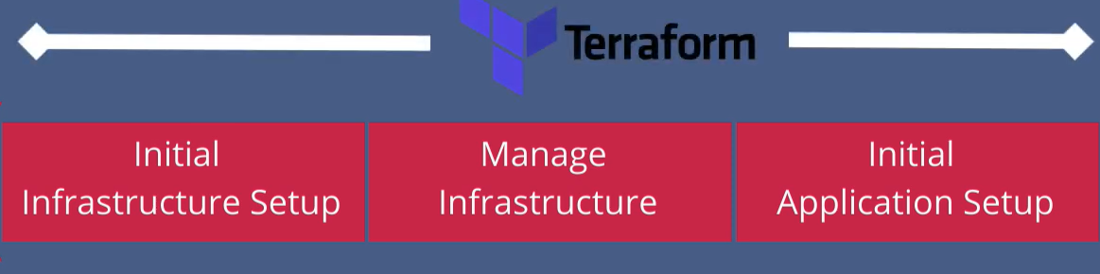
Infrastructure As Code
Using terraform To Provision Infrastructure
terraform easily provisions infrastructure across different cloud providers

Slide 4
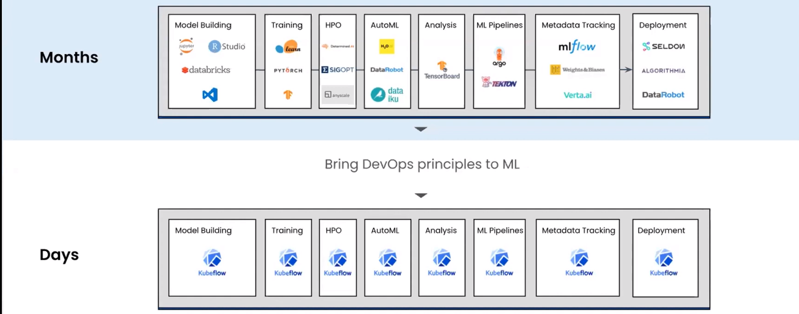
Source : arrikto
Make It even faster with REPRECSYS templates

Slide 5

Deploy Kubeflow with terraform ,Pipeline your ml code with KFP
Source : arrikto.com

Slide 6
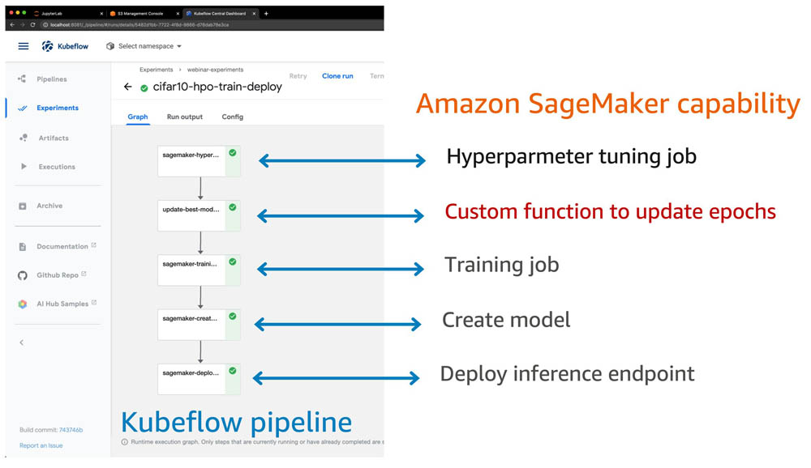

Slide 7
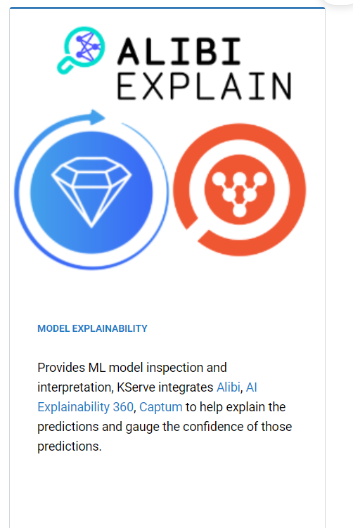
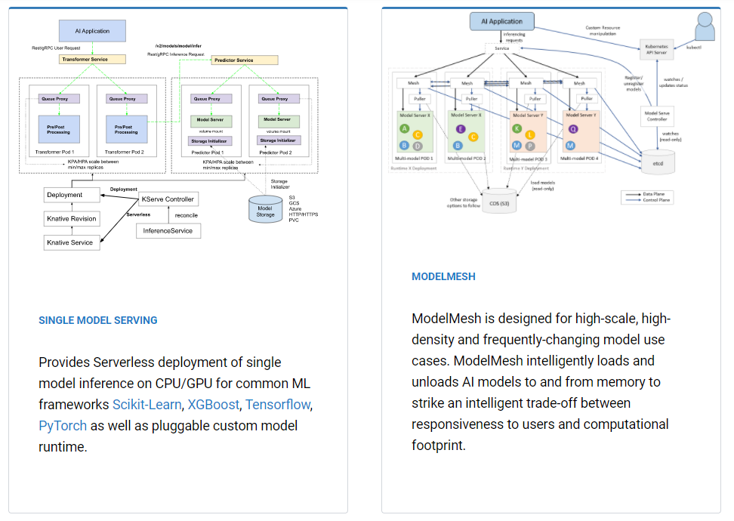
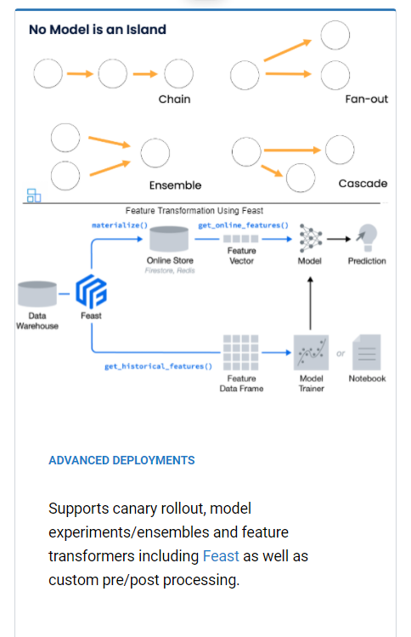

Model deployment and Inference with KServe

Slide 8
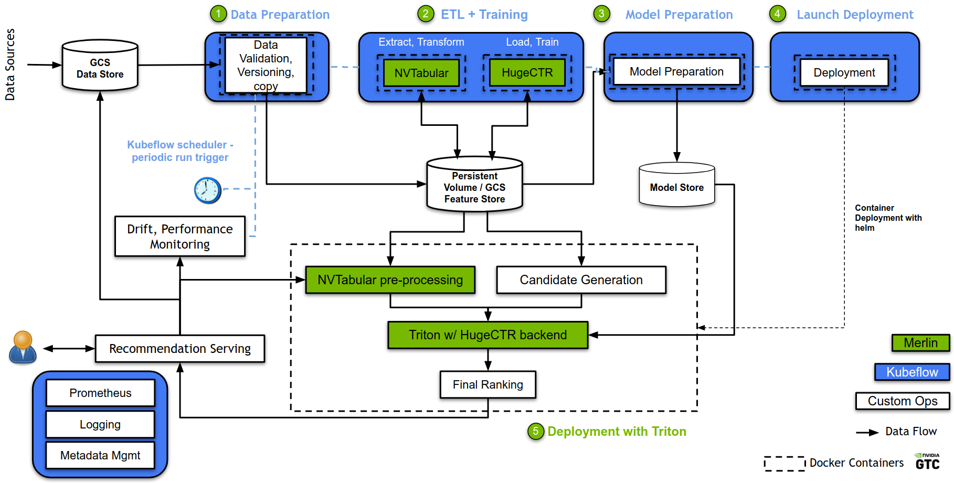
Use End to End recommender systems like NVIDIA-MERLIN on KFP (I will also make one Kubeflow components and kserve) source : https://github.com/NVIDIA-Merlin/gcp-ml-ops

Slide 9
IAT recommendation system
Users can get recommended templates that satisfies their demands
It takes in various inputs to Suggest user the most relevant IAT templates

Slide 10


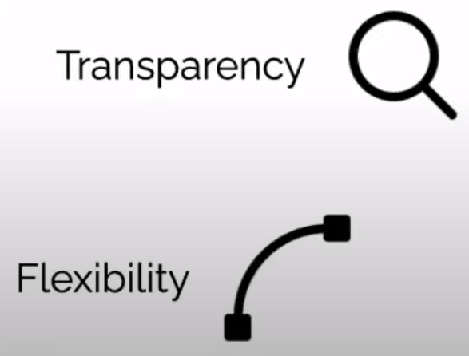

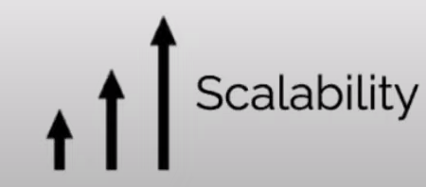
Goals

